Slide 1

#LifeKoKaroLift
Post-Graduate Diploma in ML/AI

Slide 2



Course : Machine Learning
Lecture On : XGBoost
Instructor : Manish Kumar

Slide 3

Agenda
Gradient Boosting
Gradient Descent
XGBoost vs Gradient boosting
Regularization
Math’s behind Xgboost
Code Demo ☺

Slide 4
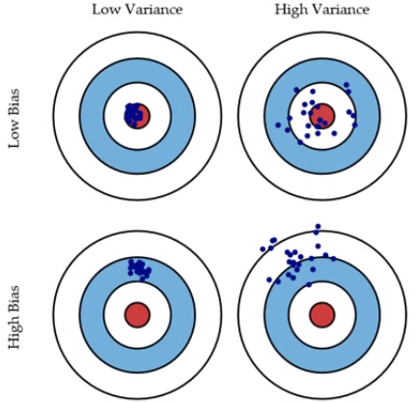
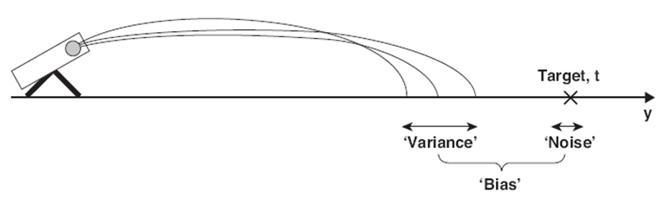
Bias and Variance in regression models
The prediction error for any machine learning algorithm can be broken down into three parts:
Bias Error
Variance Error
Irreducible Error
The irreducible error cannot be reduced regardless of what algorithm is used. It is the error introduced from the chosen framing of the problem and may be caused by factors like unknown variables that influence the mapping of the input variables to the output variable.

Slide 5
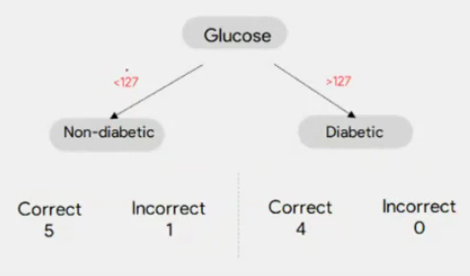
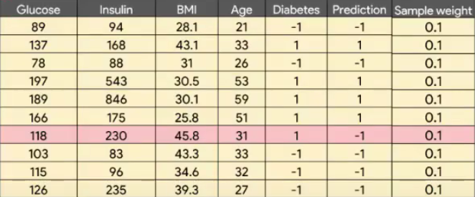
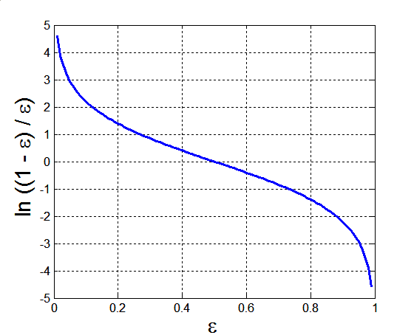
Ada Boost
The lower a classifier error rate, the more accurate it is, and therefore, the higher its weight for voting should be
Weight of a classifier C_{i}’s vote is
Error rate:
(i = index of classifier, j=index of instance)

Slide 6
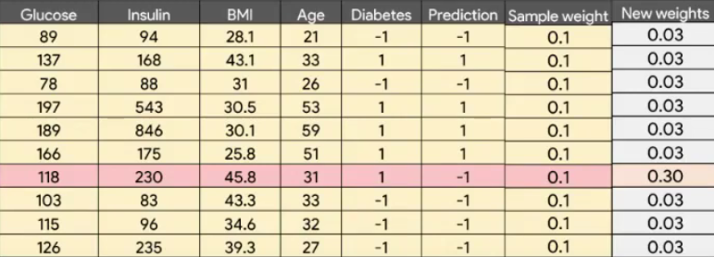
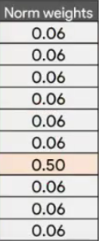
Ada Boost

Slide 7
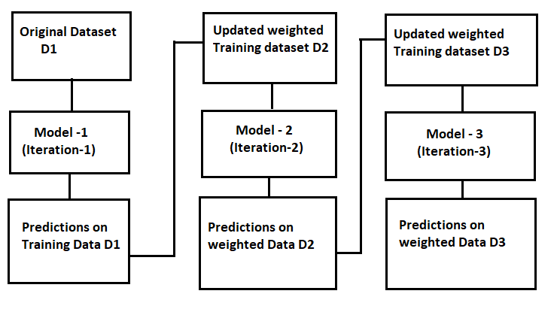
Ada Boost

Slide 8
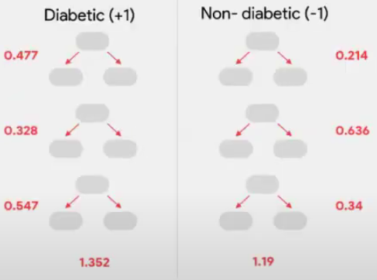
Ada Boost
Testing:
For each class c, sum the weights of each classifier that assigned class c to X (unseen data)
The class with the highest sum is the WINNER!

Slide 9
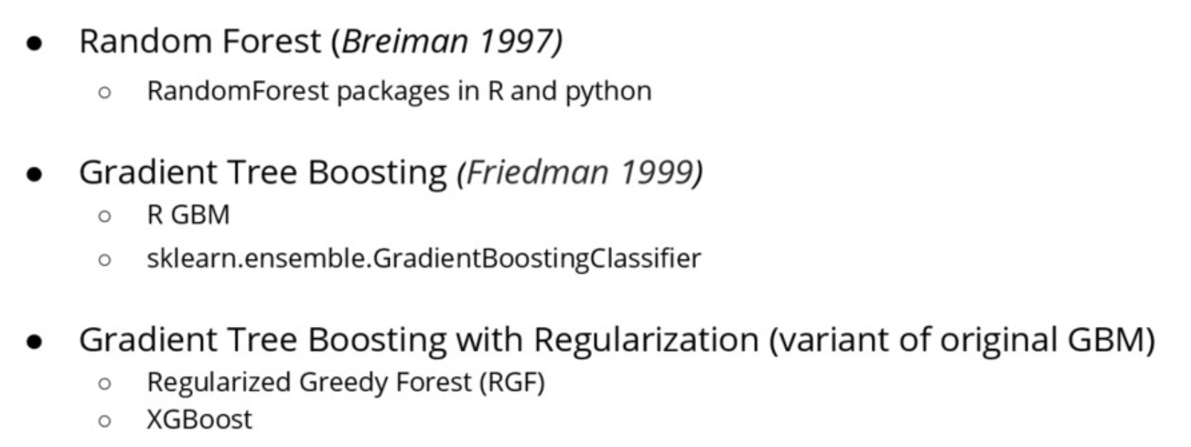
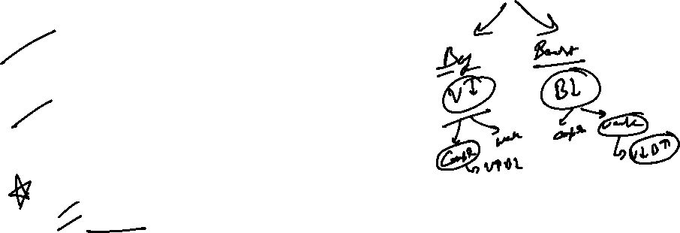
Variant of algorithms to learn Tree Ensembles

Slide 10


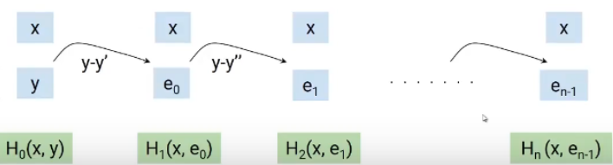
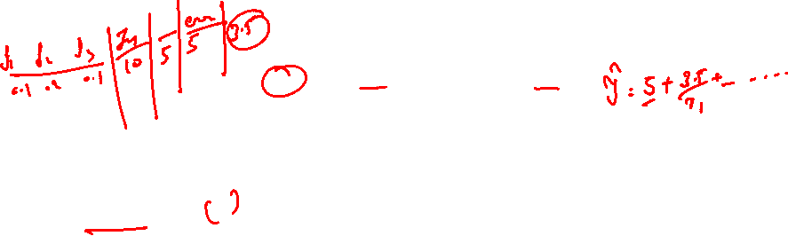
Gradient Boosting Algorithm
Like AdaBoost in GBM as well we reduce the bias of the weak learners by building models sequentially where each of the subsequent models tries to reduce the error of the previous model. But How?
Gradient boosting approaches the problem a bit differently. Instead of adjusting weights of data points, Gradient boosting focuses on the difference between the prediction and the ground truth.
M0
M1
M2
Mn
. . . . . . . .
X_train
Y_train

Slide 12

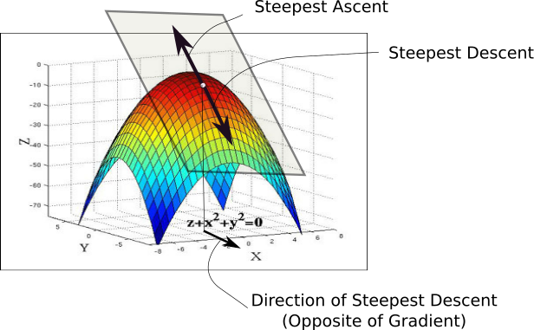
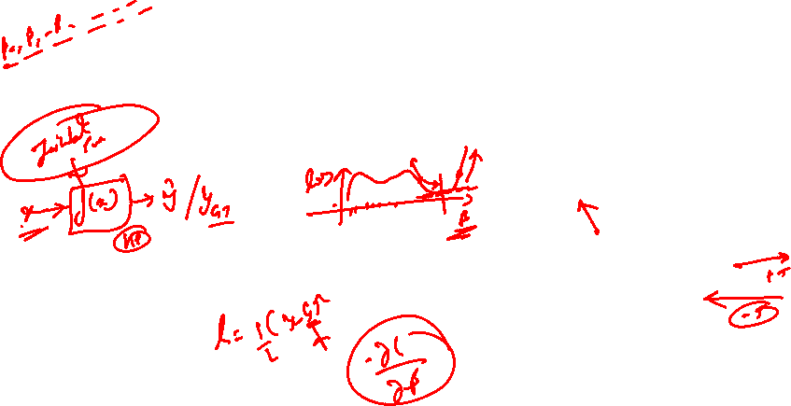
Gradient Descent
While the direction of the gradient tells us which direction has the steepest ascent, it's magnitude tells us how steep the steepest ascent/descent is. So, at the minima, where the contour is almost flat, you would expect the gradient to be almost zero. In fact, it's precisely zero for the point of minima.
Gradient descent is an optimization algorithm used to minimize some function by iteratively moving in the direction of steepest descent as defined by the negative of the gradient

Slide 13

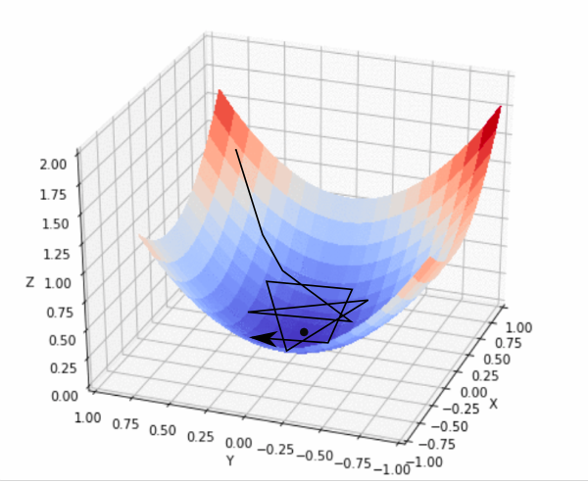
Gradient Descent
In practice, we might never exactly reach the minima, but we keep oscillating in a flat region in close vicinity of the minima. As we oscillate our this region, the loss is almost the minimum we can achieve, and doesn't change much as we just keep bouncing around the actual minimum. Often, we stop our iterations when the loss values haven't improved in a pre-decided number, say, 10, or 20 iterations. When such a thing happens, we say our training has converged, or convergence has taken place.

Slide 14
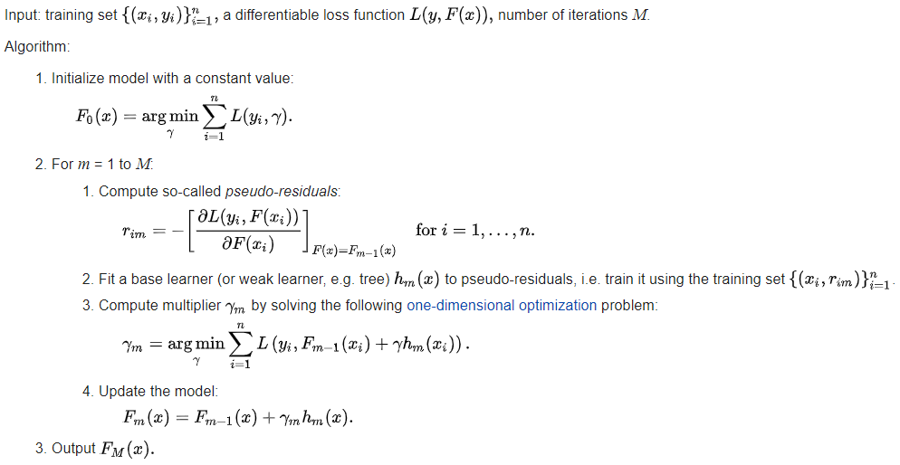


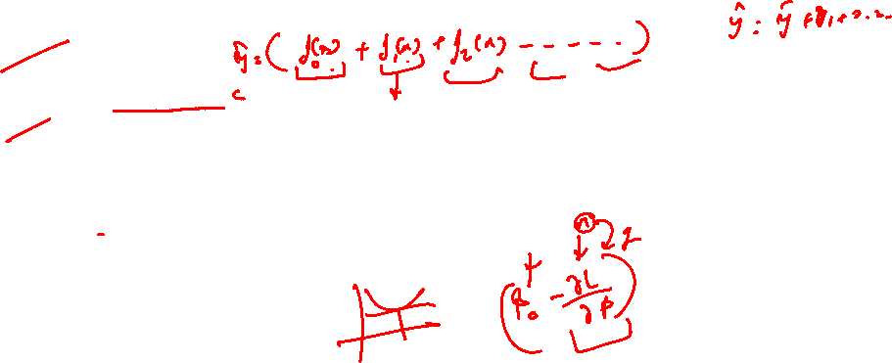
Gradient Boosting Algorithm
https://statweb.stanford.edu/~jhf/ftp/trebst.pdf

Slide 15
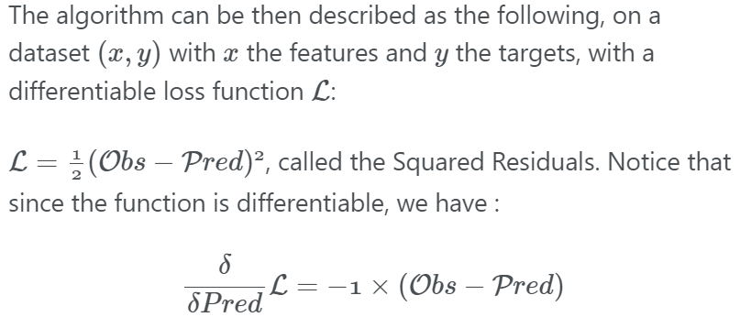

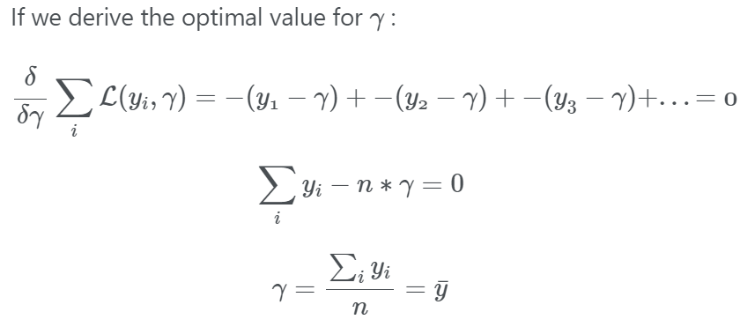
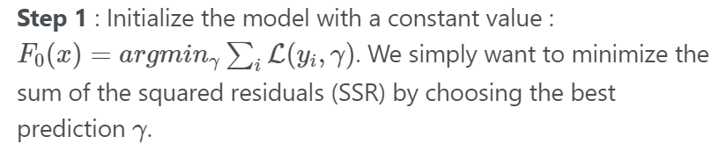
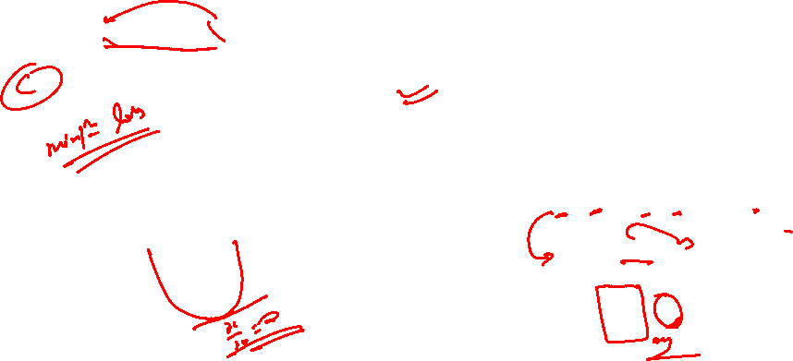
Gradient Boosting Algorithm

Slide 16
Gradient Boosting Algorithm
Area(Sq-ft) | Room(BHK) | Furnished | Rent(K) | Average(K)
480 | 2 | Y | 15 | 27.7
255 | 1 | Y | 10 | 27.7
800 | 1 | N | 35 | 27.7
785 | 2 | N | 39 | 27.7
900 | 3 | Y | 55 | 27.7
350 | 1 | Y | 12 | 27.7
Step 1 : Calculate the average of the target label
For regression, we start with a leaf that is the average value of the target variable. This leaf will be used as a baseline to approach the correct solution in the next steps.

Slide 17
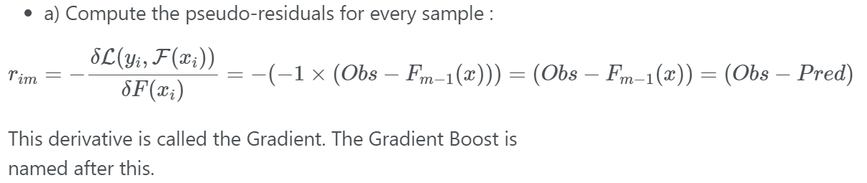
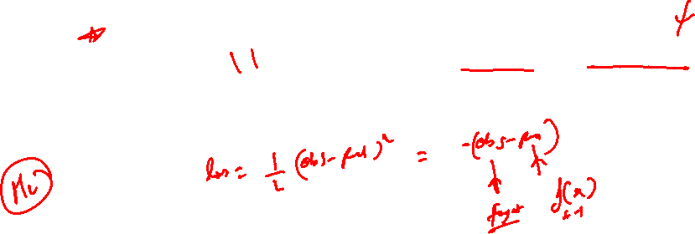
Gradient Boosting Algorithm
Step 2 : For m = 1 to M (the maximum number of trees specified, e.g 100)

Slide 18
Gradient Boosting Algorithm
Area(Sq-ft) | Room(BHK) | Furnished | Rent(K) | Average(K) | Residual
480 | 2 | Y | 15 | 27.7 | -12.7
255 | 1 | Y | 10 | 27.7 | -17.7
800 | 1 | N | 35 | 27.7 | 7.3
785 | 2 | N | 39 | 27.7 | 11.3
900 | 3 | Y | 55 | 27.7 | 27.3
350 | 1 | Y | 12 | 27.7 | -15.7
Step 2 : Calculate the residual for every sample in the dataset

Slide 19
Gradient Boosting Algorithm
Area(Sq-ft) | Room(BHK) | Furnished | Rent(K) | Average(K) | Residual
480 | 2 | Y | 15 | 27.7 | -12.7
255 | 1 | Y | 10 | 27.7 | -17.7
800 | 1 | N | 35 | 27.7 | 7.3
785 | 2 | N | 39 | 27.7 | 11.3
900 | 3 | Y | 55 | 27.7 | 27.3
350 | 1 | Y | 12 | 27.7 | -15.7
Sq footage> 500
Furnished Y/N
Room > 1
27.3K
7.3K, 11.3K
-12.7K
-17.7K,-15.7K

Slide 20
Gradient Boosting Algorithm
Area(Sq-ft) | Room(BHK) | Furnished | Rent(K) | Average(K) | Residual
480 | 2 | Y | 15 | 27.7 | -12.7
255 | 1 | Y | 10 | 27.7 | -17.7
800 | 1 | N | 35 | 27.7 | 7.3
785 | 2 | N | 39 | 27.7 | 11.3
900 | 3 | Y | 55 | 27.7 | 27.3
350 | 1 | Y | 12 | 27.7 | -15.7
Sq footage> 500
Furnished Y/N
Room > 1
27.3K
9.3K
-12.7K
-17.7K,-15.7K

Slide 21
Gradient Boosting Algorithm
Area(Sq-ft) | Room(BHK) | Furnished | Rent(K) | Average(K) | Residual | Residual
480 | 2 | Y | 15 | 27.7 | -12.7 | -12.7
255 | 1 | Y | 10 | 27.7 | -17.7 | -16.7
800 | 1 | N | 35 | 27.7 | 7.3 | 9.3
785 | 2 | N | 39 | 27.7 | 11.3 | 9.3
900 | 3 | Y | 55 | 27.7 | 27.3 | 27.3
350 | 1 | Y | 12 | 27.7 | -15.7 | -16.7
Step 3 : Construct the model on top of residuals
We will now build a model(decision tree) which is aimed at predicting residuals. In other words, every leaf will contain a prediction as to the value of the residual

Slide 22
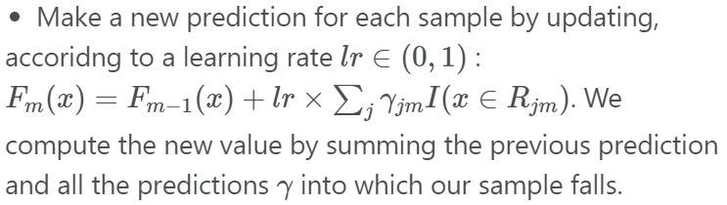
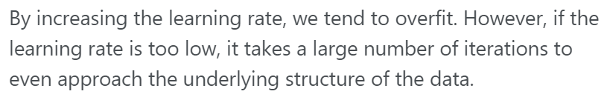
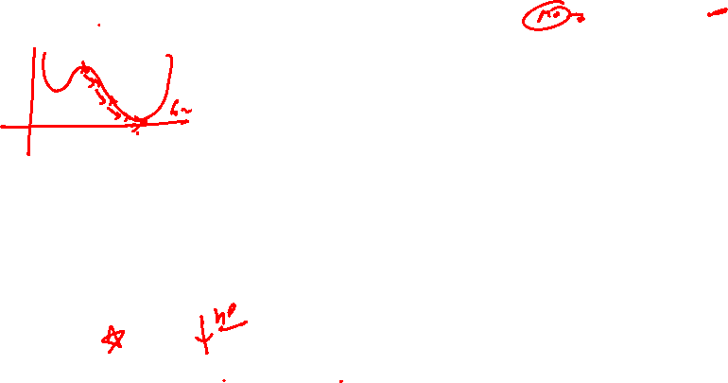
Gradient Boosting Algorithm
Area(Sq-ft) | Room(BHK) | Furnished | Rent(K) | Average(K) | Residual | Pedicted
480 | 2 | Y | 15 | 27.7 | -12.7 | 26.4
255 | 1 | Y | 10 | 27.7 | -17.7 | 26
800 | 1 | N | 35 | 27.7 | 7.3 | 28.6
785 | 2 | N | 39 | 27.7 | 11.3 | 28.6
900 | 3 | Y | 55 | 27.7 | 27.3 | 30.4
350 | 1 | Y | 12 | 27.7 | -15.7 | 26
Learning Rate is used to scale the contribution from the new tree. This results in a small step in the right direction of prediction. Empirical evidence has proven that taking lots of small steps in the right direction results in better prediction with a testing dataset i.e the dataset that the model has never seen as compared to the perfect prediction in 1st step. Learning Rate is usually a small number like 0.1
Step 4 : Compute the predictions
27.7K(Average rent) + 0.1(LR)(Residual of the sample) = New Prediction
27.7 +0.1*(-12.7) = 26.4

Slide 23
Gradient Boosting Algorithm
Area(Sq-ft) | Room(BHK) | Furnished | Rent(K) | Average(K) | Residual | Pedicted | New-Residual
480 | 2 | Y | 15 | 27.7 | -12.7 | 26.4 | -11.4
255 | 1 | Y | 10 | 27.7 | -17.7 | 26 | -16
800 | 1 | N | 35 | 27.7 | 7.3 | 28.6 | 6.4
785 | 2 | N | 39 | 27.7 | 11.3 | 28.6 | 10.4
900 | 3 | Y | 55 | 27.7 | 27.3 | 30.4 | 24.6
350 | 1 | Y | 12 | 27.7 | -15.7 | 26 | -14
Step 5 : Compute the new residuals
New residuals of the sample = Actual rent – predicted rent

Slide 24
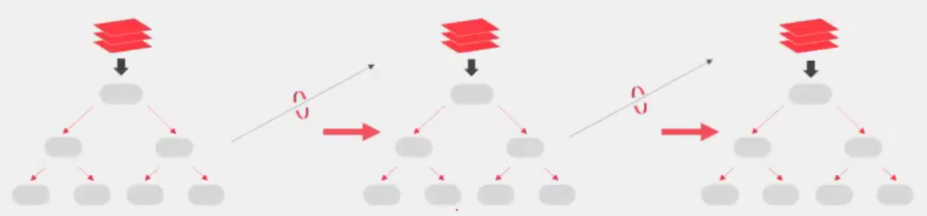
Gradient Boosting Algorithm
Prediction : Use all of the trees in the ensemble to make a final prediction
27.7K + 0.1*(-12.7) + 0.1*(-11.4) + …

Slide 25
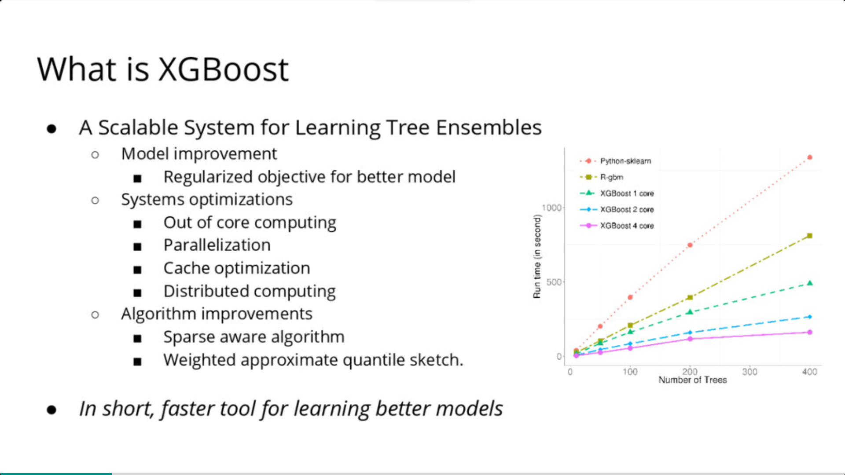
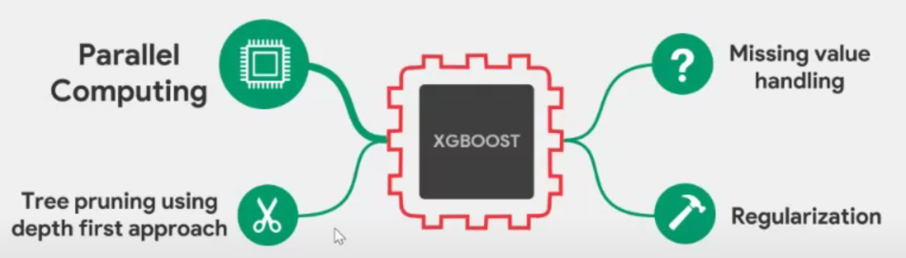

What is Xgboost

Slide 26
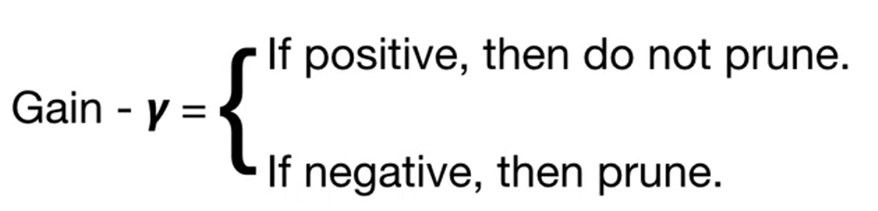
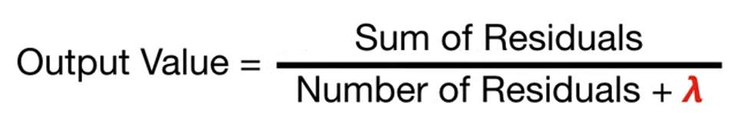
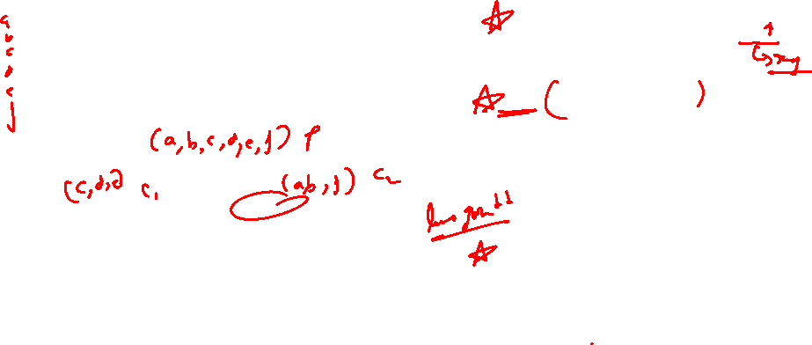
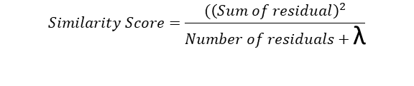
Extreme/Regularized Gradient Boosting Algorithm
Area(Sq-ft) | Room(BHK) | Furnished | Rent(K) | Average(K) | Residual
480 | 2 | Y | 15 | 27.7 | -12.7
255 | 1 | Y | 10 | 27.7 | -17.7
800 | 1 | N | 35 | 27.7 | 7.3
785 | 2 | N | 39 | 27.7 | 11.3
900 | 3 | Y | 55 | 27.7 | 27.3
350 | 1 | Y | 12 | 27.7 | -15.7
$$Similarity Score=\frac{{(\left(Sum of residual\right)}^{2}}{Number of residuals+\text{λ}}$$
And then we prune the tree by calculating the tree difference between Gain values and a user defined Tree Complexity Parameter, γ
Sq footage> 500
Furnished Y/N
Room > 1
27.3K
9.3K
-12.7K
-17.7K,-15.7K
Notes:
Lambda is a regularization parameter and when lambda is +ve it results in more pruning, by shrinking the similarity scores, and it results in smaller output values

Slide 27
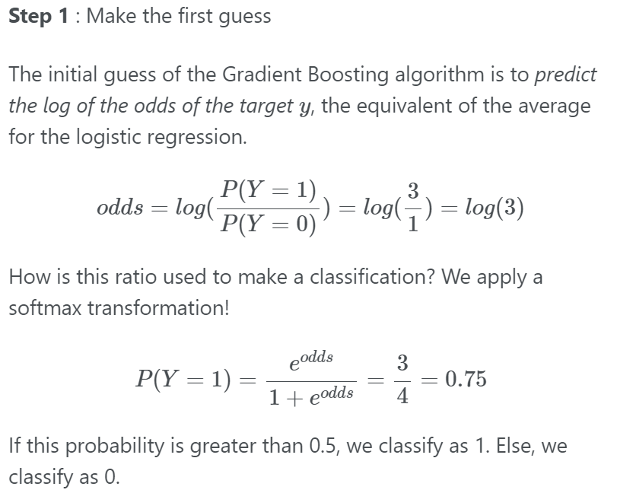
Gradient Boosting Algorithm - Classification

Slide 28
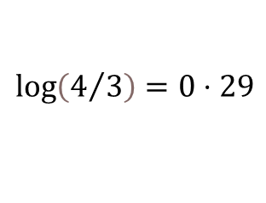
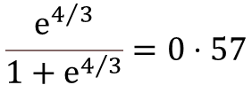
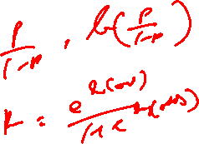
Gradient Boosting Algorithm
Age | Sex | Pclass | Survived | Initial Pred
22 | M | 3 | 0 | 0.57
38 | F | 1 | 1 | 0.57
26 | F | 1 | 1 | 0.57
35 | F | 1 | 1 | 0.57
54 | M | 3 | 0 | 0.57
2 | M | 3 | 1 | 0.57
43 | M | 3 | 0 | 0.57
Step 1 : Calculate the initial Prediction for every individual -> log(odds)
We can’t use the value directly, since it needs to be converted to a probability value. To do so, we will use the logistic function to transform it to a probability.
$$\log\left(4/3\right)=0⋅29$$
$$\frac{ⅇ^{4/3}}{1+ⅇ^{4/3}}=0⋅57$$
Probability of surviving

Slide 29
Gradient Boosting Algorithm
Age | Sex | Pclass | Survived | Initial Pred | Residual
22 | M | 3 | 0 | 0.57 | -0.57
38 | F | 1 | 1 | 0.57 | 0.43
26 | F | 1 | 1 | 0.57 | 0.43
35 | F | 1 | 1 | 0.57 | 0.43
54 | M | 3 | 0 | 0.57 | -0.57
2 | M | 3 | 1 | 0.57 | 0.43
43 | M | 3 | 0 | 0.57 | -0.57
Step 2 : Calculate the pseudo-residual for every sample dataset

Slide 30
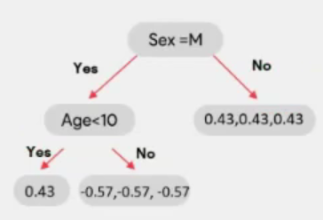
Gradient Boosting Algorithm
Age | Sex | Pclass | Survived | Initial Pred | Residual
22 | M | 3 | 0 | 0.57 | -0.57
38 | F | 1 | 1 | 0.57 | 0.43
26 | F | 1 | 1 | 0.57 | 0.43
35 | F | 1 | 1 | 0.57 | 0.43
54 | M | 3 | 0 | 0.57 | -0.57
2 | M | 3 | 1 | 0.57 | 0.43
43 | M | 3 | 0 | 0.57 | -0.57
Step 3 : Construct the model on top of residuals
We will now build a model(decision tree) which is aimed at predicting residuals. In other words, every leaf will contain a prediction as to the value of the residual

Slide 31
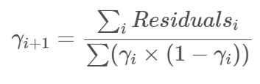
Gradient Boosting Algorithm
Age | Sex | Pclass | Survived | Initial Pred | Residual
22 | M | 3 | 0 | 0.57 | -0.57
38 | F | 1 | 1 | 0.57 | 0.43
26 | F | 1 | 1 | 0.57 | 0.43
35 | F | 1 | 1 | 0.57 | 0.43
54 | M | 3 | 0 | 0.57 | -0.57
2 | M | 3 | 1 | 0.57 | 0.43
43 | M | 3 | 0 | 0.57 | -0.57
Step 3 : Construct the model on top of residuals

Slide 32
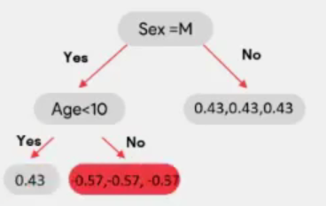

Gradient Boosting Algorithm
Age | Sex | Pclass | Survived | Initial Pred | Residual
22 | M | 3 | 0 | 0.57 | -0.57
38 | F | 1 | 1 | 0.57 | 0.43
26 | F | 1 | 1 | 0.57 | 0.43
35 | F | 1 | 1 | 0.57 | 0.43
54 | M | 3 | 0 | 0.57 | -0.57
2 | M | 3 | 1 | 0.57 | 0.43
43 | M | 3 | 0 | 0.57 | -0.57
Step 3 : Construct the model on top of residuals
$$\frac{−0⋅57−0⋅57−0⋅57}{0⋅57\left(1−0⋅57\right)+0.57\left(1−0⋅57\right)+0⋅57\left(1−0⋅57\right)}=−2.3$$

Slide 33

Gradient Boosting Algorithm
Age | Sex | Pclass | Survived | Initial Pred | Residual | Leaf Output | New log Odds
22 | M | 3 | 0 | 0.57 | -0.57 | -2.3 | -1.09
38 | F | 1 | 1 | 0.57 | 0.43 | 1.75 | 1.34
26 | F | 1 | 1 | 0.57 | 0.43 | 1.75 | 1.34
35 | F | 1 | 1 | 0.57 | 0.43 | 1.75 | 1.34
54 | M | 3 | 0 | 0.57 | -0.57 | -2.3 | -1.09
2 | M | 3 | 1 | 0.57 | 0.43 | 1.75 | 1.34
43 | M | 3 | 0 | 0.57 | -0.57 | -2.3 | -1.09
Step 4 : Compute the predictions
New log(odds) = initial log(odds) + LR(Output value by D.T) -> log(4/3) = 0.29
New log(odds) = 0.29 +0.6(-2.3) = -1.09
New log(odds) = 0.29+0.6(1.75) = 1.34

Slide 34
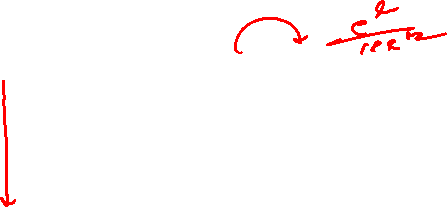
Gradient Boosting Algorithm
Age | Sex | Pclass | Survived | Initial Pred | Residual | Leaf Output | New log Odds | New Pred | New Residual
22 | M | 3 | 0 | 0.57 | -0.57 | -2.3 | -1.09 | 0.25 | -0.25
38 | F | 1 | 1 | 0.57 | 0.43 | 1.75 | 1.34 | 0.8 | 0.2
26 | F | 1 | 1 | 0.57 | 0.43 | 1.75 | 1.34 | 0.8 | 0.2
35 | F | 1 | 1 | 0.57 | 0.43 | 1.75 | 1.34 | 0.8 | 0.2
54 | M | 3 | 0 | 0.57 | -0.57 | -2.3 | -1.09 | 0.25 | -0.25
2 | M | 3 | 1 | 0.57 | 0.43 | 1.75 | 1.34 | 0.8 | 0.2
43 | M | 3 | 0 | 0.57 | -0.57 | -2.3 | -1.09 | 0.25 | -0.25
Step 5 : Build another tree on top of this residual

Slide 35
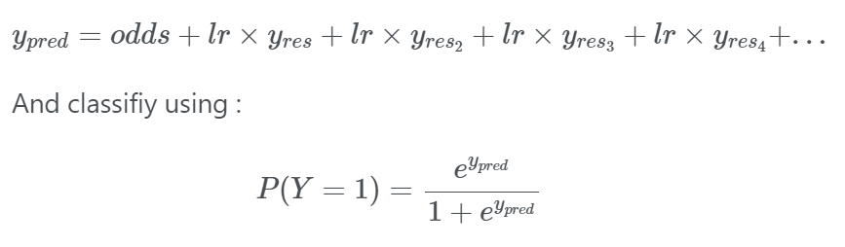
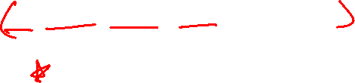
Gradient Boosting Algorithm
Age | Sex | Pclass | Survived | Initial Pred | Residual | Leaf Output | New log Odds | New Pred | New Residual
22 | M | 3 | 0 | 0.57 | -0.57 | -2.3 | -1.09 | 0.25 | -0.25
38 | F | 1 | 1 | 0.57 | 0.43 | 1.75 | 1.34 | 0.8 | 0.2
26 | F | 1 | 1 | 0.57 | 0.43 | 1.75 | 1.34 | 0.8 | 0.2
35 | F | 1 | 1 | 0.57 | 0.43 | 1.75 | 1.34 | 0.8 | 0.2
54 | M | 3 | 0 | 0.57 | -0.57 | -2.3 | -1.09 | 0.25 | -0.25
2 | M | 3 | 1 | 0.57 | 0.43 | 1.75 | 1.34 | 0.8 | 0.2
43 | M | 3 | 0 | 0.57 | -0.57 | -2.3 | -1.09 | 0.25 | -0.25

Slide 36
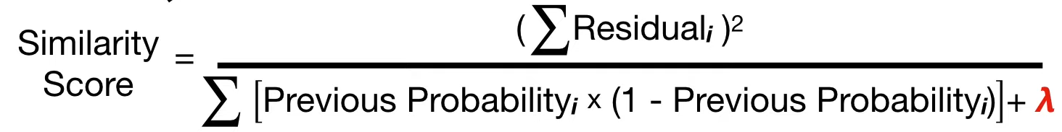
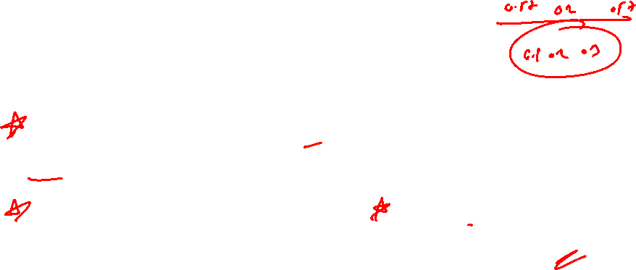
Extreme/Regularized Gradient Boosting Algorithm
Age | Sex | Pclass | Survived | Initial Pred | Residual | Leaf Output | New log Odds | New Pred | New Residual
22 | M | 3 | 0 | 0.57 | -0.57 | -2.3 | -1.09 | 0.25 | -0.25
38 | F | 1 | 1 | 0.57 | 0.43 | 1.75 | 1.34 | 0.8 | 0.2
26 | F | 1 | 1 | 0.57 | 0.43 | 1.75 | 1.34 | 0.8 | 0.2
35 | F | 1 | 1 | 0.57 | 0.43 | 1.75 | 1.34 | 0.8 | 0.2
54 | M | 3 | 0 | 0.57 | -0.57 | -2.3 | -1.09 | 0.25 | -0.25
2 | M | 3 | 1 | 0.57 | 0.43 | 1.75 | 1.34 | 0.8 | 0.2
43 | M | 3 | 0 | 0.57 | -0.57 | -2.3 | -1.09 | 0.25 | -0.25
And then we prune the tree by calculating the tree difference between Gain values and a user defined Tree Complexity Parameter, γ

Slide 37

Xgboost

Slide 38

Xgboost

Slide 39
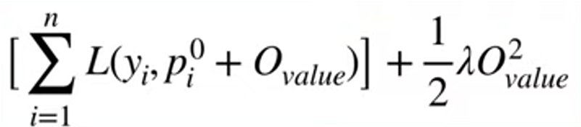
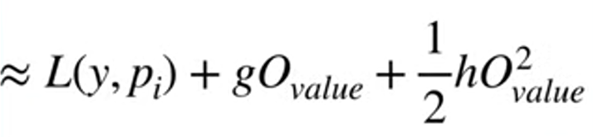
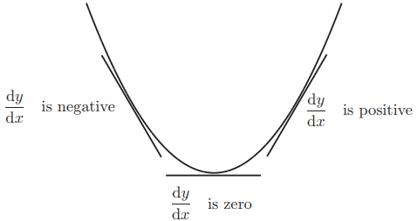
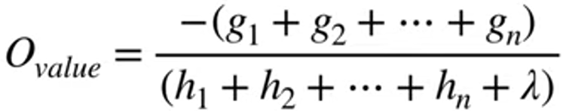

Xgboost

Slide 40





Xgboost

Slide 41





Xgboost

Slide 42







Xgboost

Slide 43


Slide 44


Slide 45

#LifeKoKaroLift
Thank You!

